Slide 1

Anomaly Detection
Notes:
Welcome to the introduction to big data apps and Appcenter.
Today, we’ll cover relevant information pertaining to the launch scheduled this month. This is intended to be sales training/introduction and we will not drill into technical content. R&D is developing KTS (mid Feb) that will cover the details of AppCenter.
Been working with the field organization to refine the messages and to build a program that helps you sell more Aster.

Slide 2
Agenda
Anomaly detection Introduction
Different algorithms in Anomaly detection in un-supervised learning space (its brief overview of algorithms used, for in detail functionality please check out reference links)
Implementation of Anomaly detection (Go through on implementation in Jupiter notebook)

Slide 3
What is Anomaly Detection and how it is different from Outlier?
The terms are largely used in an interchangeable way. "Outlier" refers to something lying outside the norm - so it is "anomalous".
An outlier is far away data point that’s far away from the mean or median in a distribution. It may be unusual but still within realm of reality. An anomaly is illegitimate data point that is generated from a different process than whatever generated rest of the data.
But I have the impression that "outlier" is usually used for very rare observations. In statistics, on a normal distribution, you would consider three sigma to be outliers.
When we talk about outliers, we typically mean an unusual data point in the data used to fit our model, where as an anomaly is usually meant as an unusual data point in a dataset outside of the data used to fit our model.

Slide 4
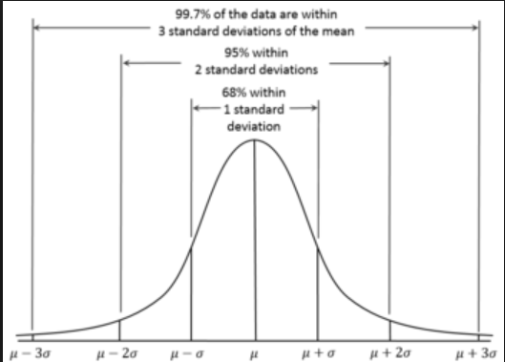
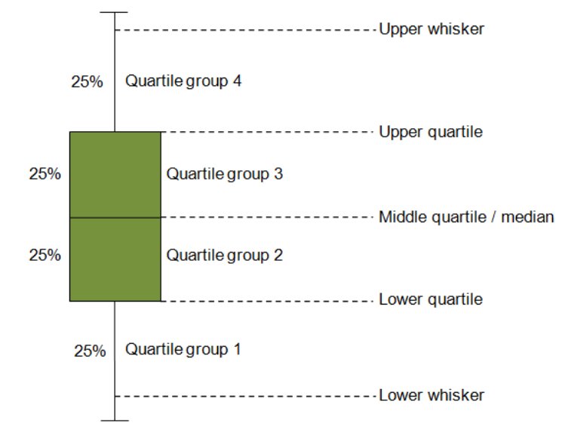
Anomaly Detection for Univariate Variable (Unsupervised)
Normal Distribution
Box plot

Slide 5
Major Techniques – Unsupervised Anomaly detection
Isolation Forest
One Class SVM
Auto encoder
Box plot outliers
DBscan (Density based clustering as opposed to Distance based like Euclidean Distance)
Kalman Filter

Slide 6
Algorithm Control in Unsupervised Anomaly Detection - Threshold
Why Threshold? Cant use - Precision and Recall like in Supervised learning
Let say we have 100 data points and 20 Anomalies in the same.
if we predicted 25 as anomalies but out of 25, 15 are actually anomalies and rest 10 are errors
Precision –then your precision is 15/25 = 0.60
Recall – then your recall is 15/20 = 0.75
If we predicted all 100 as anomalies then your recall will be 100% but Precision will be 15/100 = .15
Precision is "how useful the search results are", and recall is "how complete the results are". We have to strike balance between the two.
In Unsupervised learning, since we don’t have label data above measures can’t be calculated so to control the algorithm we use a cut-off point/Threshold which helps us keep tab on no of anomalies detected. Threshold help us control how much % of the total dataset to be classified as anomalies.

Slide 7
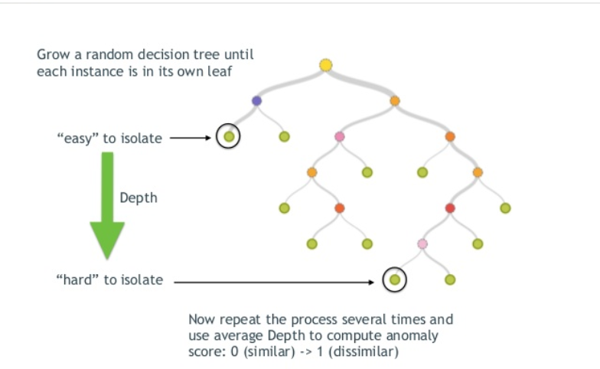
Isolation Forest
The Isolation Forest algorithm isolates observations by randomly selecting a feature and then randomly selecting a split value between the maximum and minimum values of the selected feature. The logic arguments goes: isolating anomaly observations is easier as only a few conditions are needed to separate those cases from the normal observations. On the other hand, isolating normal observations require more conditions. Therefore, an anomaly score can be calculated as the number of conditions required to separate a given observation.

Slide 8
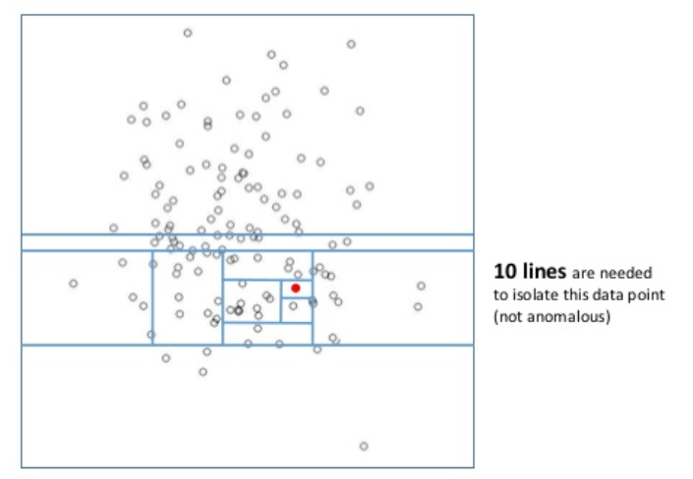
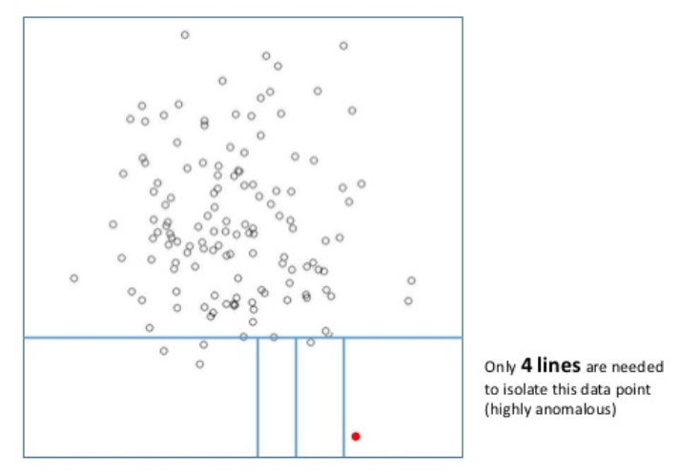
Isolation Forest

Slide 9
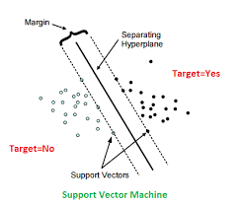
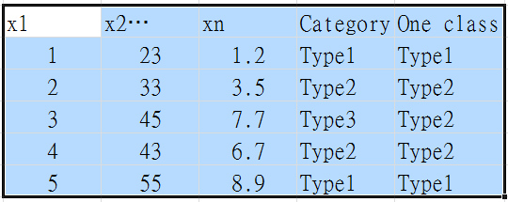
One class SVM
Basically separates all the data points from the origin (in feature space F) and maximizes the distance from this hyper-plane to the origin. This results in a binary function which captures regions in the input space where the probability density of the data lives. Thus the function returns +1 in a “small” region (capturing the training data points) and −1 elsewhere. In Unsupervised learning the vectors which are close to origin form one class and which are away from it becomes another class

Slide 10
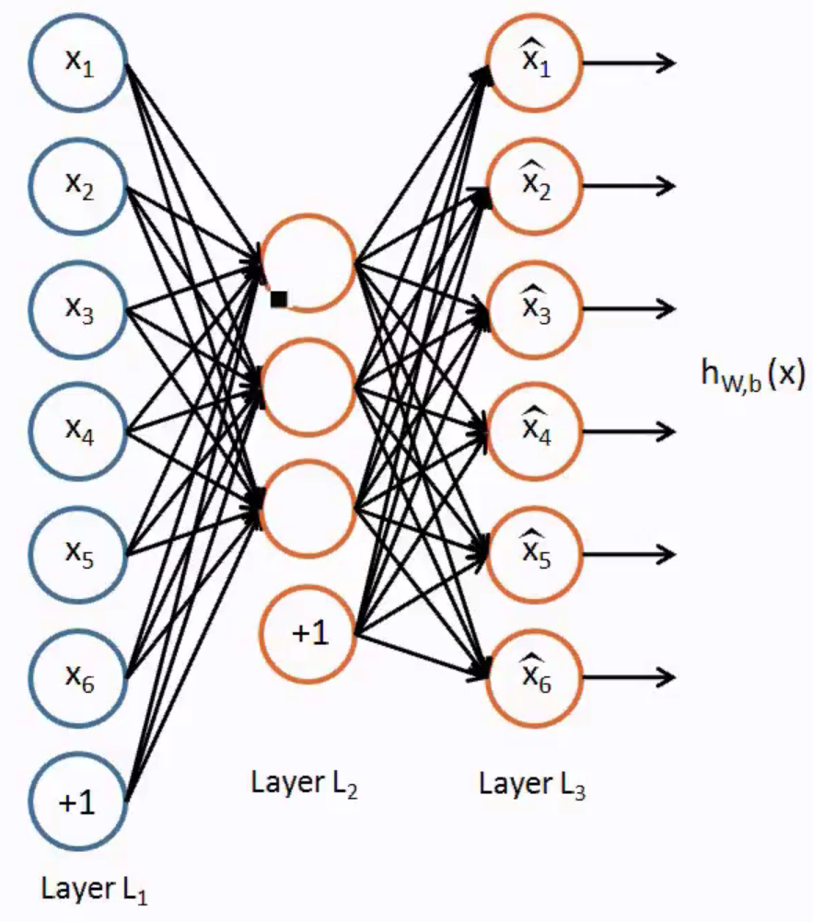
Auto-encoders
Feed forward neural network containing only one hidden layer. Basically output regenerates its inputs by encoding them first and then decoding. This way it collates (encodes) all the information in the short space (Hidden layers) in the process keeps important properties which is seen overall in the dataset and throws out unimportant ones.

Slide 11
Applications
Machine failure/abnormality detection
Security threat / Virus detection
Invalid transaction/Fraud detection
And many more…

Slide 12
Reference links
Auto encoders: https://www.youtube.com/watch?v=vfnxKO2rMq4
SVM: https://www.youtube.com/watch?v=mTyT-oHoivA
Isolation Forest: https://www.slideshare.net/turi-inc/anomaly-detection-using-isolation-forests
H2o documentation: http://docs.h2o.ai/h2o/latest-stable/h2o-py/docs/frame.html

